Slide 1

AIRLINE PROJECT
TEAM MEMBERS-
AARTI JANGIR (MA23M016)
BADAL KUMAR(MA23M004)
ROHIT KUMAR (MA23M011)

Slide 2
ABOUT THE PROJECT:
We are given with preprocessed airline data set containing information about the feedback about the airline services
This data contains information about following fields:
◼ aircraft ◼ traveller_type ◼ seat_type ◼ route ◼ date_flown ◼ recommended 3 ◼ trip_verified ◼ rating ◼ seat_comfort ◼ cabin_staff_service ◼ food_beverages ◼ ground_service ◼ value_for_money ◼ entertainment

Slide 3
OBJECTIVES :
Our main goal in this project is to find optimum solutions of the problems faced by travelers and make strategies to improve facilities given by various aircrafts.
To analyze the sentimental data given in the data frame, extract useful information from the data and make inferences about it.

Slide 4
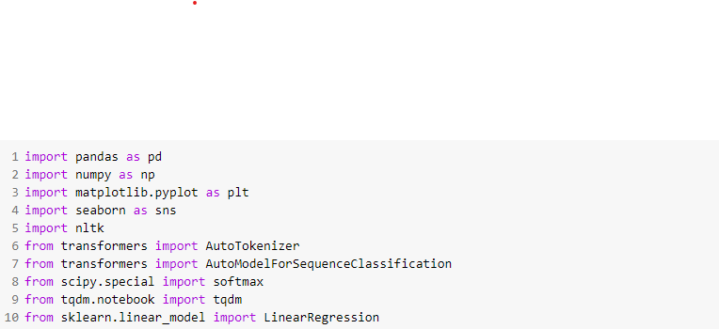
Libraries used :
PANDAS
NUMPY
MATPLOTLIB
SEABORN
NLTK(Natural Language Tool Kit)

Slide 5
What is Sentimental Analysis?

Slide 6
Sentiment analysis is the process of analyzing digital text to determine if the emotional tone of the message is positive, negative, or neutral. Today, companies have large volumes of text data like emails, customer support chat transcripts, social media comments, and reviews. Sentiment analysis tools can scan this text to automatically determine the author’s attitude towards a topic. Companies use the insights from sentiment analysis to improve customer service and increase brand reputation.

Slide 7
How does sentiment analysis work? Sentiment analysis is an application of natural language processing (NLP) technologies that train computer software to understand text in ways similar to humans. The analysis typically goes through several stages before providing the final result. Preprocessing During the preprocessing stage, sentiment analysis identifies key words to highlight the core message of the text. Tokenization breaks a sentence into several elements or tokens. Lemmatization converts words into their root form. For example, the root form of am is be. Stop-word removal filters out words that don't add meaningful value to the sentence. For example, with, for, at, and of are stop words.

Slide 8
Keyword analysis
NLP technologies further analyze the extracted keywords and give them a sentiment score. A sentiment score is a measurement scale that indicates the emotional element in the sentiment analysis system. It provides a relative perception of the emotion expressed in text for analytical purposes. For example, researchers use 10 to represent satisfaction and 0 for disappointment when analyzing customer reviews.

Slide 9
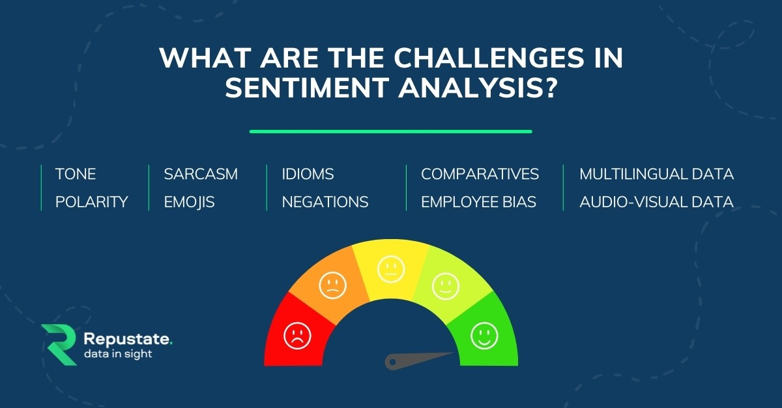

Slide 10
Polarity
Although the emotional tone in some sentences can be very apparent and robust (e.g., “It was a terrible experience.”), the others are not easily classified as positive, negative, or neutral (e.g., “The service quality is not mentionable.”). So, the polarity of the statement cannot always be easily inferred by the algorithms.
Negation Detection
Just because a sentence contains negation (e.g., no, not, -non, -less, -dis), it does not mean that the overall sentiment of the statement is negative. Current negation detection methods are not sufficient to classify the sentiment correctly. For instance, “It was not unpleasant” is a statement with negation and can be classified by the algorithm as negative, but it conveys a positive meaning.

Slide 11
Emojis
Emojis have become a part of daily life and are more effective in expressing one’s sentiment compared to words. However, as the sentiment analysis tools depend on written texts, emojis cannot be classified accurately and thus are removed from many analyses. In turn, one ends up with a noncomprehensive analysis.

Slide 12
VADER VS roBERTA
One of the well-known rule-based algorithms is VADER from the NLTK package. According to developers, it is specifically attuned to sentiments expressed in social media. It is quite easy to implement yet a very powerful model. Another algorithm, I will talk about is a deep learning-based algorithm — Twitter-roBERTa from the TRANSFORMERS package. This model was pretrained with 124 million tweets and finetuned for sentiment analysis. Both of the models do not require any training, which means they can be directly applied to textual data out of the box.

Slide 13
implementation
VADER Implementation
For VADER, clean your data as much as possible, i.e. remove mentions (usernames), URLs, hashtag symbols, and so on. As I said, it is quite easy to implement,
roBERTa Implementation
Twitter-roBERTa implementation is a bit more complicated than VADER, particularly because it does not provide a compound score we need to calculate ourselves.

Slide 14
Time required for Predictions
Time Required for Predictions
In the above two sections, we saw that accuracy of roBERTa is much higher and reflects more reality. But in the world of data science, accuracy is not alone as a determining factor. Since computational resources are limited, one of the requirements for a model is that it should be computationally light as much as possible, particularly for production. It was already obvious from the implementation code snippets that VADER is much easier to apply compared to roBERTa. Moreover, in the following figure, you can see how much VADER is fast than roBERTa. On my personal laptop, VADER predicted sentiment of 1000 tweets only in 0.31 seconds. Contrary, roBERTa did the same task in 42.6 seconds (~130-fold slower).

Slide 15
Depending on the task and computational resources available one can select VADER or roBERTa. However, with a minimalistic amount of data pre-processing and incredible accuracy, Twitter-roBERTa seems more promising, especially if the amount of data is not so big.

Slide 16
Linear regression
Linear regression attempts to model the relationship between two variables by fitting a linear equation to observed data. One variable is considered to be an explanatory variable, and the other is considered to be a dependent variable. For example, a modeler might want to relate the weights of individuals to their heights using a linear regression model. Before attempting to fit a linear model to observed data, a modeler should first determine whether or not there is a relationship between the variables of interest. This does not necessarily imply that one variable causes the other (for example, higher SAT scores do not cause higher college grades), but that there is some significant association between the two variables. A scatterplot can be

Slide 17
a helpful tool in determining the strength of the relationship between two variables. If there appears to be no association between the proposed explanatory and dependent variables (i.e., the scatterplot does not indicate any increasing or decreasing trends), then fitting a linear regression model to the data probably will not provide a useful model. A valuable numerical measure of association between two variables is the correlation coefficient, which is a value between -1 and 1 indicating the strength of the association of the observed data for the two variables.
A linear regression line has an equation of the form Y = a + bX, where X is the explanatory variable and Y is the dependent variable. The slope of the line is b, and a is the intercept (the value of y when x = 0).

Slide 18
TASKS:
Find all A380 flights
Remove all not verified trips
Find all flight details with rating above 8
Find the flight which carried more people with couple leisure, display as per the ascending order of the date
Find all flights with business seat type who has provided the lowest rating
List out all disappointed passengers

Slide 19
PROBLEM STATEMENTS :
(a) Which flight is most recommendation ratio ? (b) Which flight is least recommendation ratio ?
Find which flight has greater disappointment percentage?
Which is the busiest aircraft?
Find all the author how many times did they travel?
Find authors who gave 5 stars for value of money?
Find their class type ?
Find out the place from which has highest no. of flight took off?
Find all the flights starting from India .

Slide 20

Find the most taken route by flights .
Which flight carry the most economy class passengers ?
Find correlation between overall rating and given factors.
Observe which factors have greater (name 3) correlation with overall ratings.
Find the correlation between average rating and other factors one by one.

Slide 21
Identify the routes with lowest customers satisfaction (average ratings<3)
Which seat_type (class) has more numbers of disappointed customers?

Slide 22
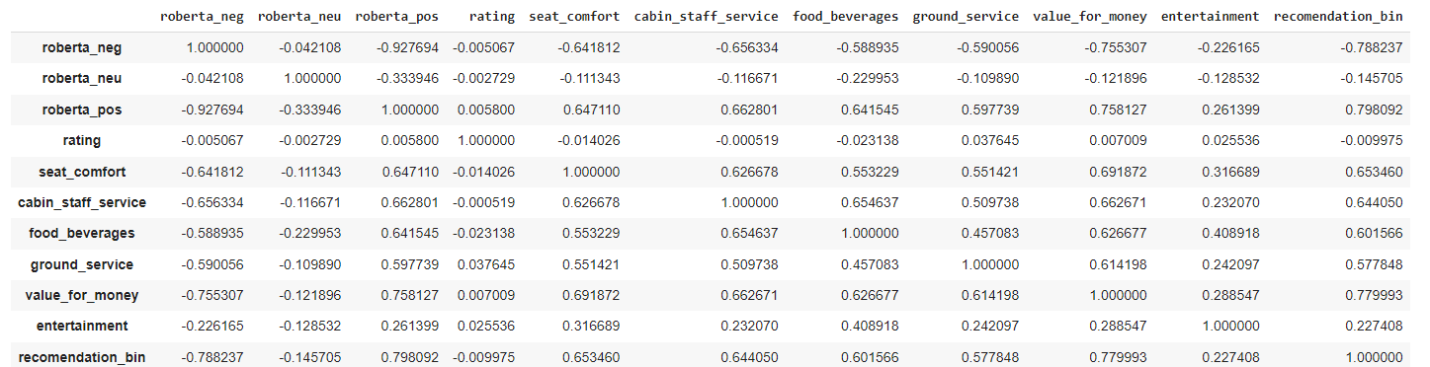
Content Analysis
Find correlation between positive emotion column and recommendation column.

Slide 23
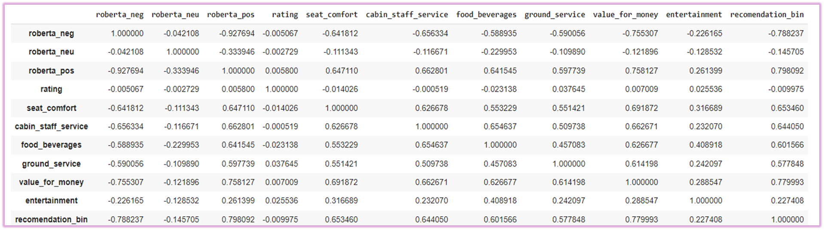
Correlation between negative emotion column and recommendation column.

Slide 24
Find correlation between positive, negative emotions and other factors

Slide 25
Observe which factors have greater correlation (top 3) with positive and negative emotions. We see that for both positive and negative emotions have strong correlation with the same factors which are:
Seat comfort
Cabin staff service
Value for money

Slide 26
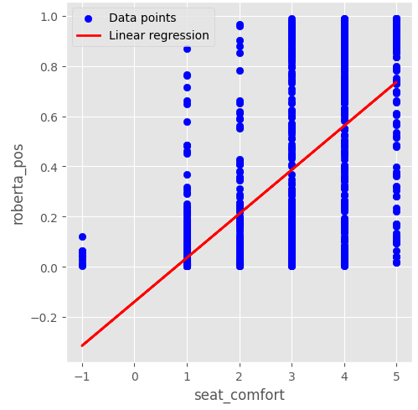
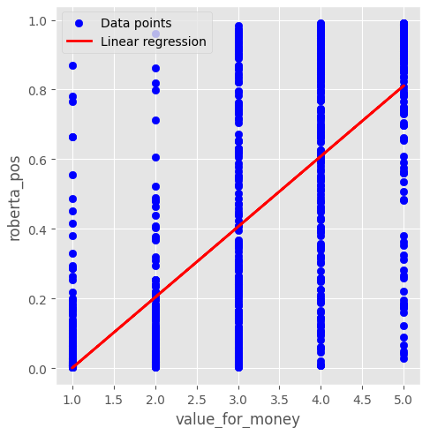
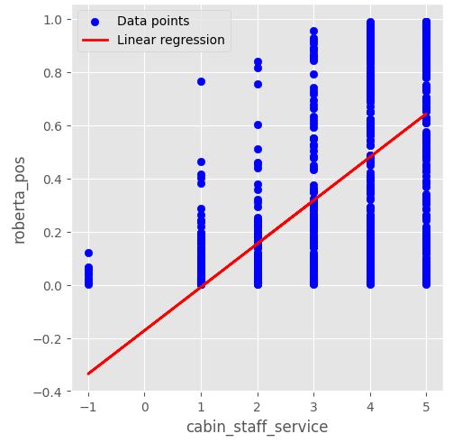
Correlation of positive emotions with seat comfort, value for money and cabin staff service

Slide 27
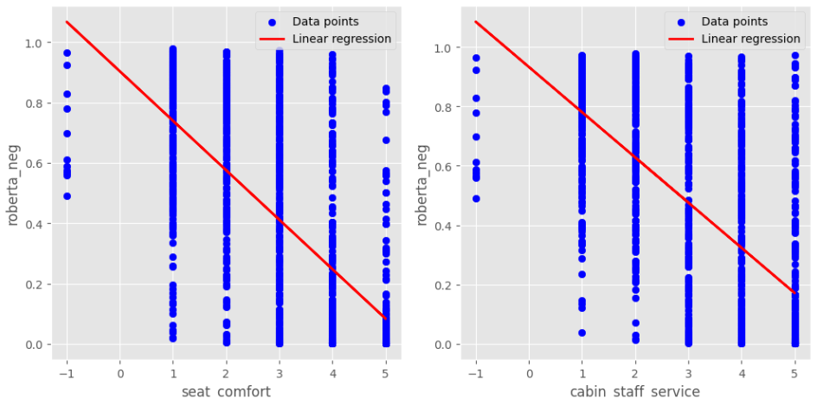
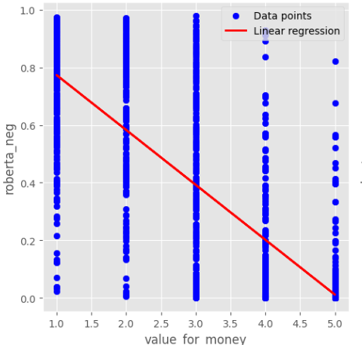
Correlation of negative emotions with seat comfort, value for money and cabin staff service

Slide 28
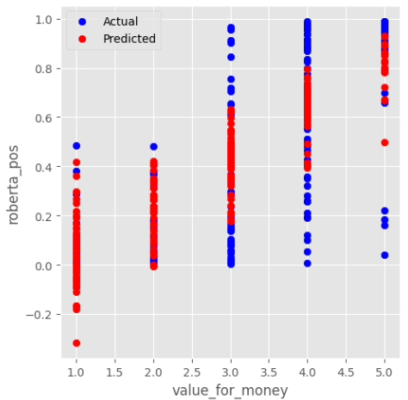
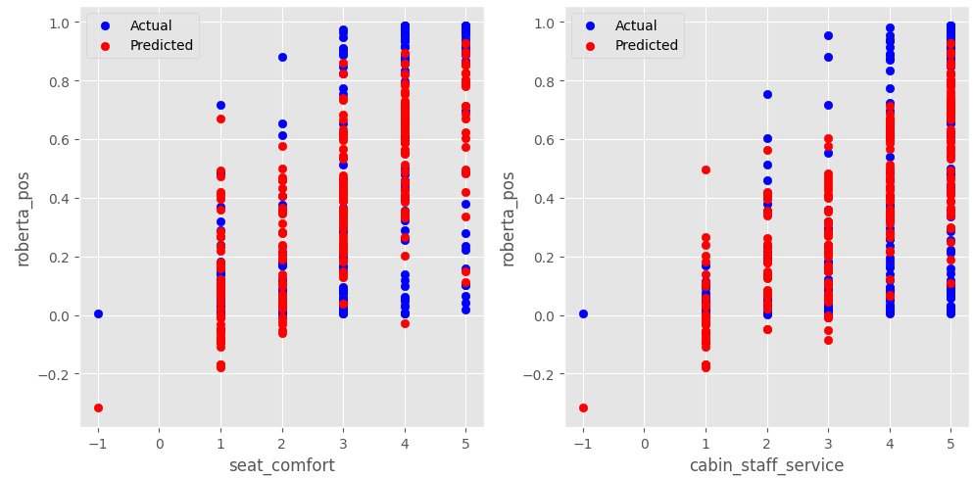
Plot actual vs predicted values for the above three factors

Slide 29
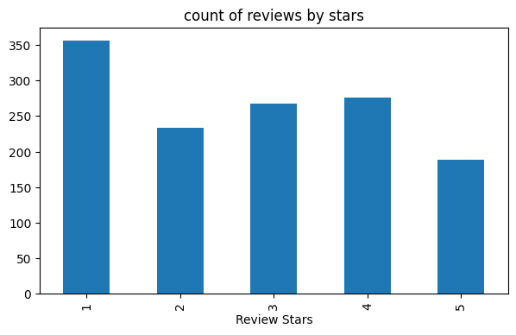
ADDRESSING THE ISSUES:
Main concerns of the travellers(based on correlation with emotions and average rating):
Value for money

Slide 30
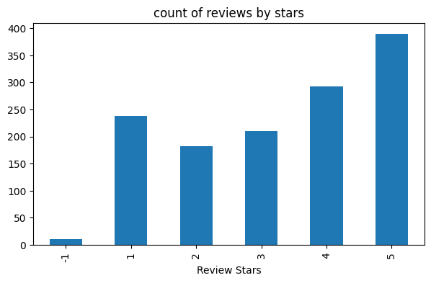
2. Cabin staff service

Slide 31
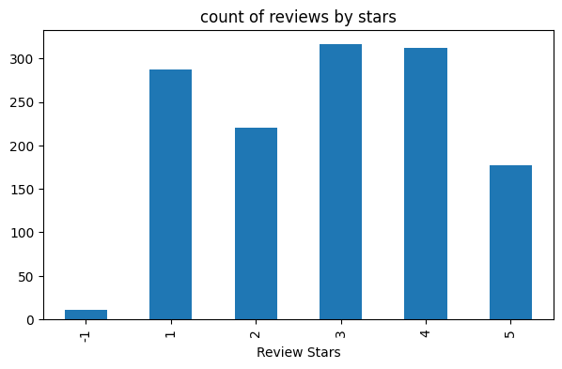
3. Seat comfortability

Slide 32
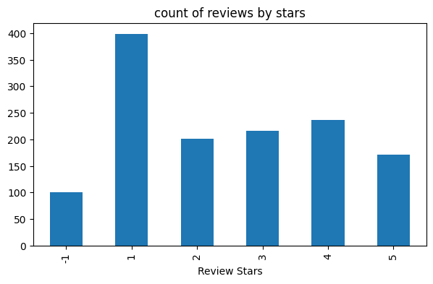
4. Food beverages

Slide 33
POSSIBLE SOLUTIONS & STRATEGIES:
Listing out main aircrafts which need improvement
Improvement in main areas(factors) of concern:
We see that A320 is the busiest aircraft and Boeing 777 has least recommendation ratio in spite of being one of busiest aircraft. So, improving services of these aircrafts will give us more benefit.
Cabin staff services
Value for money
Seat comfort
Food and beverages

Slide 34
CABIN STAFF SERVICES
Better training programs to ensure necessary skills required for delivering better services to travellers such as encouraging them to be approachable and attentive towards needs of passengers.
Conducting surveys:
Conduct random surveys after the flight to know more about what are the
specific concerns of passengers regarding the staff.
Incentives:
Implement incentive programs or performance-based rewards to motivate
staff and foster a culture of excellence.

Slide 35
VALUE FOR MONEY
Clear and transparent billing structure:
detailed breakdowns of fares and extra charges
Enhancing the quality of services
Conduct surveys after flight mainly focusing on this factor
Give seasonal discounts and implement loyalty program offers for the passengers to the passengers who travelled more than once.
Monitor market trends and charge accordingly

Slide 36
SEAT COMFORTABILITY
Improvement in seat material
Adjustable features such as headrests, armrests and footrests to passengers for more comfortability.
Maintenance of quality on a regular basis.
Maintain cleanliness of seats and bacteria free environment in the aircraft.
Conduct surveys mainly focusing on feedback on hygiene .

Slide 37
FOOD BEVERAGES
Offering diverse meal options
High quality ingredients
Feedback from passengers regarding quality and quantity of food.

